Slide 1
Proximity Sensors: Capacitive

Slide 2
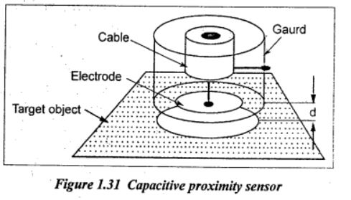
Capacitive Proximity Sensors

Slide 3
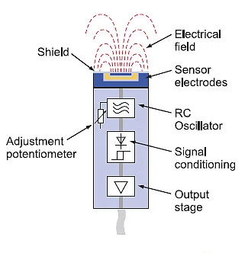
Capacitive Proximity Sensors

Slide 4
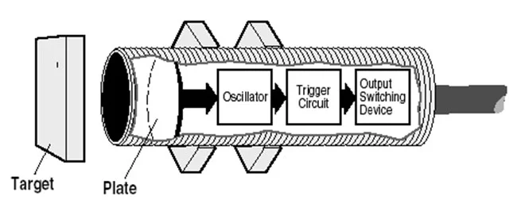
Capacitive Proximity Sensors

Slide 5
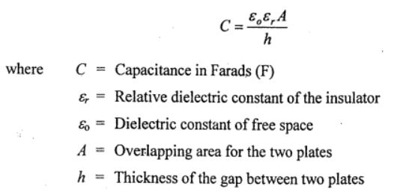
Capacitive Proximity Sensors
Capacitive proximity sensors are contactless sensors that detect both metallic and non-metallic objects including liquid, powders, and granular. It operates by detecting a change in capacitance.
Capacitive sensors can directly sense a variety of things such as motion, displacement, chemical composition, electric field and indirectly sense many other variables which can be converted into motion or dielectric constant such as pressure, acceleration, fluid level and fluid composition.
A capacitance sensor consists of two metal plates separated by an air gap. The capacitance C between terminals is given by the expression.

Slide 6
Capacitive Proximity Sensors(Working)
Capacitive proximity sensor produces an electrostatic field
When an object (conductive/non-conductive) approaches the sensing area, the capacitance of both plates increases, resulting in oscillator amplitude gain
The resulted amplitude gain triggers sensor output switch
*Note: Capacitive sensors only oscillate when the target object is present

Slide 7
Capacitive Proximity Sensors(Advantages)
Contactless detection
A wide array of materials able to be detected
Able to detect objects through non-metallic walls with its wide sensitivity band
Well-suited to be used in an industrial environment
Contains potentiometer that allows users to adjust sensor sensitivity, such that only wanted objects will be sensed
No moving parts, ensuring a longer service life.
Excellent linearity over entire dynamic range when area is changed (since stray electric fields are small)
It has high sensitivity.
Capacitive displacement detectors can detect 10-14 m displacement with good stability, high speed and wide extremes of environment.
High accuracy and resolution are possible. A resolution of 2.5 x 1O-3 can be obtained.

Slide 8
Capacitive Proximity Sensors(Disadvantages)
It is very much sensitive to changes in environmental conditions such as temperature, humidity etc. This will affect the performance.
The measurement of capacitance is hard compared to measurement of resistance.
Capacitive proximity sensor are not so accurate compared to inductive sensor type.

Slide 9
Capacitive Proximity Sensors(Applications)
Industrial usages
Production automation machines that count products, product transfers
Filling processes, pipelines, inks, etc.
Fluid level, composition, and pressure
Moisture control
Non-invasive content detection
Touch applications

